Slide 1

A Novel Framework for Efficient Offloading of
Communication Operations to Bluefield SmartNICs
Kaushik Kandadi Suresh, Benjamin Michalowicz, Bharath Ramesh,
Nick Contini, Jinghan Yao, Shulei Xu, Aamir Shafi, Hari Subramoni, Dhabaleswar Panda
{kandadisuresh.1, michalowicz.2, ramesh.113, contini.26, yao.877, xu.2452, shafi.16, subramoni.1, panda.2}@osu.edu
Department of Computer Science and Engineering
The Ohio State University

Slide 2
Introduction: SmartNICs in HPC
MPI is the de-facto programming model in High Performance Computing (HPC)
HPC applications have computation and communication
MPI non-blocking primitives allows compute and communication overlap
MPI
NVIDIA BlueField2 Data Processing Unit (DPU)
  SoC with 8 ARM core, 16 GB RAM, ConnectX6 network adaptor
The ARM cores can appear on the network as any other host
Offloading Mechanism :
  Launch process, Execute tasks for host, Inform completion.
Compute
CPU
CPU
SmartNIC
(a) Non-Bocking Transfer with Host Progression
(b) Non-Bocking Transfer offloaded to SmartNICs
Notes:
MPI has non-blocking primitives that will allow us to overlap computation with communication. The amount of overlap achieved depends on the implementation of the non-blocking primitives.
One possibility is to perform the progress of the non-blocking calls on the host , in which case the application will have to call mpi_test method frequently on host to progress the communication as shown in figure (a). This may not achieve a good overlap as the same CPU is involved in the communication and computation. Another possibility is to offload the progression of the communication to another device and perform only the computation. This could achieve a better overlap. SmartNICs can be programmed to perform this progression. NVIDIA ’s bluefield data processing unit is one example of a SmartNIC that has 8 ARM cores, with 16 Gb….. This device can be configured to appear a any other host on the network with an independent address space. One can execute run custom programs to perform any kind of cpu or network operations on these cores.

Slide 3
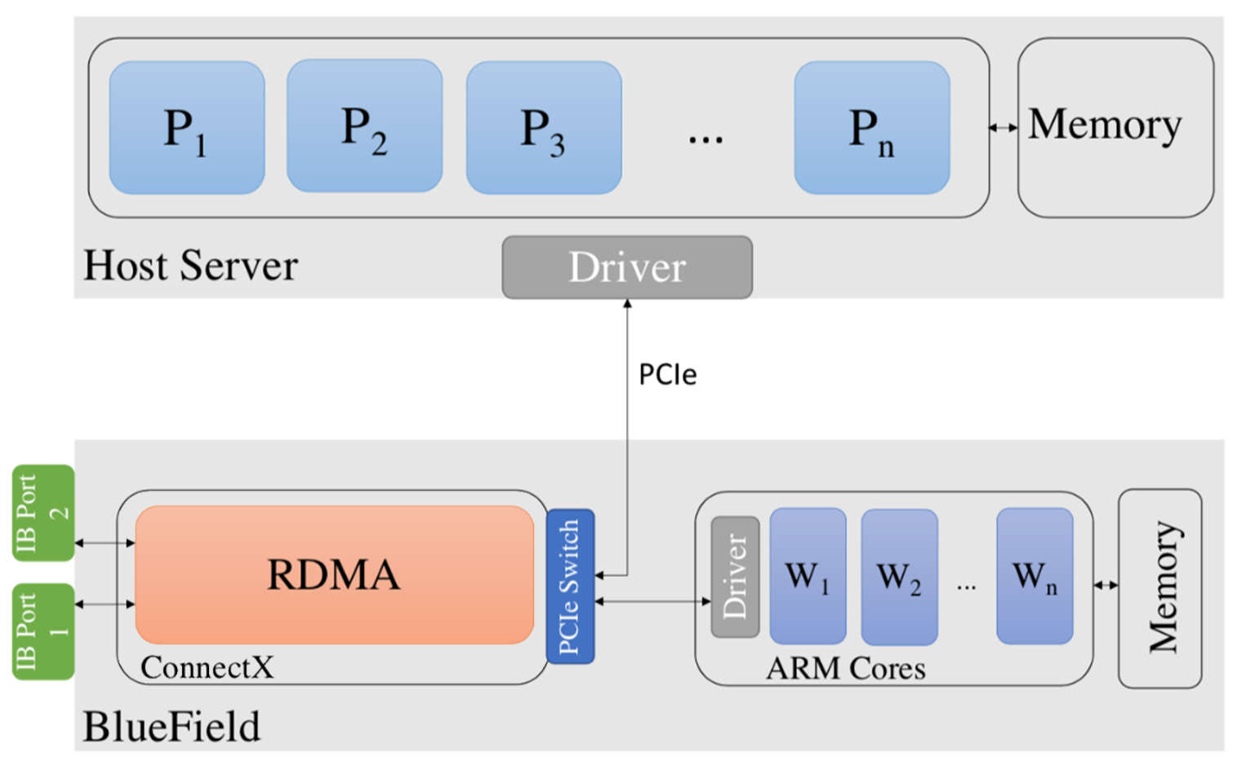
BlueField DPU / Smart NIC Architecture
BlueField includes the ConnectX6 network adapter and data processing cores
System-on-chip containing 64-bit ARMv8 A72
BlueField DPU has two modes of operation:
Separated Host mode
  The ARM cores can appear on the network as any other host and the main CPU
Embedded CPU Function Ownership mode
  Packet processing

Slide 4
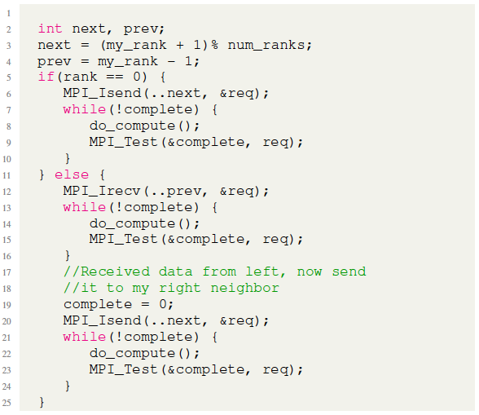
Ring Broadcast with MPI

Slide 5
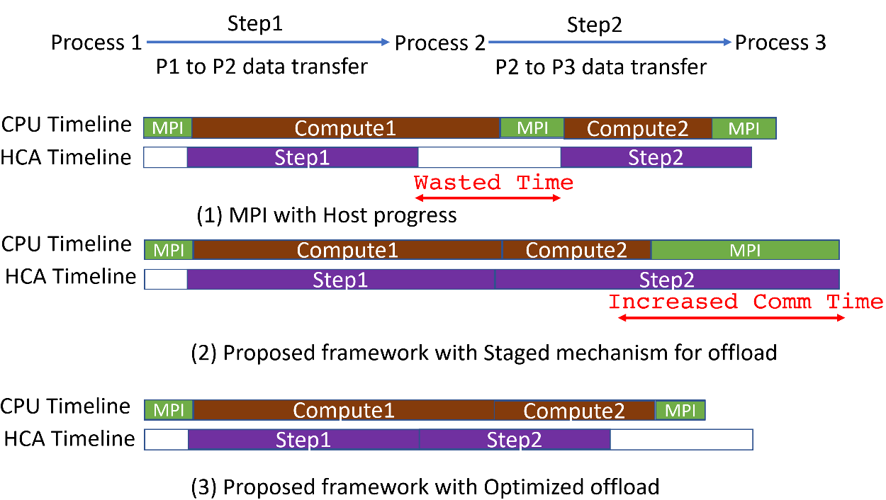
Research Problem

Slide 6
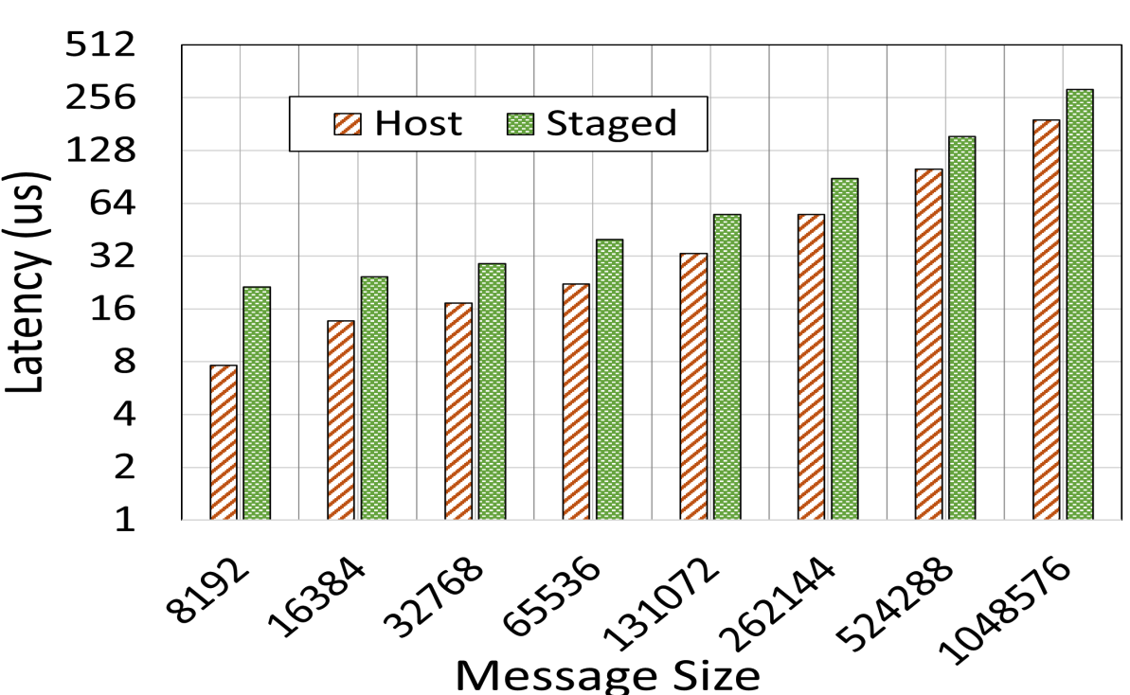
Problems with the Existing Offload framework
BluesMPI^{[1]} is a prior work that offloads certain MPI collectives to the DPU
  Eg: Ring based broadcast in HPL
Overhead of staging
Staged Offload
NODE 1
NODE 2
DPU
DPU
Host Memory
Host Memory
1
DPU Memory
DPU Memory
DPU
DPU
2
NODE 1
NODE 2
RDMA Read
RDMA Write
TX/RX Unit
Staged offload by DPU requires 2 RDMA operations:
  Local-Host-to-DPU Read, DPU-to-Remote-Host Write
Host-to-host latency with and without staged offload
[1] Mohammadreza Bayatpour, Nick Sarkauskas, Hari Subramoni, Jahanzeb Maqbool Hashmi, and Dhabaleswar K. Panda. 2021. BluesMPI: Efficient MPI Non-blocking Alltoall Offloading Designs on Modern BlueField Smart NICs. In High Performance Computing: 36th International Conference, ISC High Performance 2021

Slide 7
Contributions
Propose a framework with APIs to conveniently express the offload of generic communication patterns to the DPU
Propose basic and optimized designs to implement the APIs
Demonstrate the efficacy of the proposed designs on real systems using micro-benchmarks and applications.

Slide 8
Optimized Offload Mechanism
NODE 1
NODE 2
RDMA Read
DPU
DPU
Host Memory
Host Memory
RDMA Write
DPU Memory
1
DPU Memory
DPU
DPU
TX/RX Unit
GVMI Transfer
Guest Virtual Machine ID (GVMI) is a capability provided by the Bluefield DPUs
  Allows DPU process to move data from one local to any remote host process without staging.
Introduces addition overheads:
  Host-level, DPU-level memory registrations and key-exchanges
We provide efficient designs by amortizing the GVMI overheads

Slide 9
Application Results
P3DFFT
HPL
10%
20%
16 Nodes 32 PPN
Proposed* Scheme at-least 20% better than BluesMPI
16 Nodes 32 PPN
Proposed* Scheme at-least 8% better than HPL-1ring
* Our Designs will be available in the upcoming release of MVAPICH2-DPU

Slide 10
Conclusion & Future Research Directions
Conclusion
  Proposed a set of new primitives for DPU offload
  Designed and implemented the proposed primitives
  Optimized the implementation with additional caching
  Showed Application-level improvements
Future Work
  Accelerate additional applications such as Octopus
  Offload OpenSHMEM based applications

Slide 11


THANK YOU!
Network Based Computing
Laboratory
Network-Based Computing Laboratory
http://nowlab.cse.ohio-state.edu/
The High-Performance MPI/PGAS
Project
http://mvapich.cse.ohio-state.edu/
The High-Performance Big Data
Project
http://hibd.cse.ohio-state.edu/
The High-Performance Deep Learning
Project
http://hidl.cse.ohio-state.edu/

